Slide 1
Qn: One mole of an ideal gas is heated from 100 K to 300 K. Calculate ∆S if
the volume is kept constant and (b) the pressure is kept constant.
Assume that Cv = 3/2 R
Ans: (a) ∆S = Cv ln(T2/T1)
=3/2 x 8.314 ln (300/100)
(b) ∆S = Cp ln(T2/T1)
= (Cv+R) ln(T2/T1)
= (3/2+1)R ln(T2/T1)

Slide 2
S-7: Free energy and EMF of cell, Nernst Equation
Dt. 14/12/2021

Slide 3
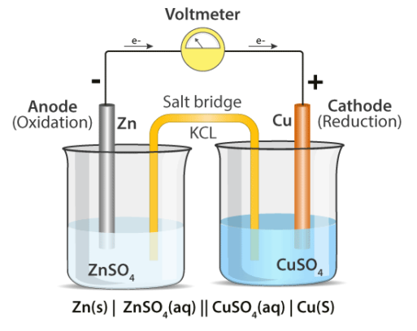
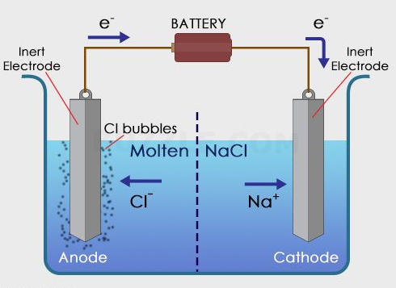
Electrolytic cell vs Galvanic cell
At anode: Zn (s) Zn²⁺ (aq.) + 2 e-, E⁰ = 0.76 V
At cathode: Cu²⁺ (aq.) + 2e⁻ Cu (s), E⁰ = 0.34 V
Net reaction: Zn (s) + Cu ²⁺ (aq.) Zn²⁺ (aq.) + Cu (s)
The cell potential, E_{cell} = 0.34 + 0.76 = 1.1 V
At anode: Cl⁻ ½ Cl₂ (g) + e⁻
At cathode: Na⁺ + e⁻ Na

Slide 4
Electrolytic cell | Electrochemical cell
Electrical energy is converted to chemical energy | Chemical energy is converted into electrical energy
An input of energy is required for the redox reactions to proceed in these cells, i.e. the reactions are non-spontaneous | The redox reactions that take place in these cells are spontaneous in nature
Anode is positive and cathode is negative electrode | Anode is negative and cathode is positive electrode
The external battery supplies the electrons. The electrons enter through the cathode and come out through the anode | The electrons are supplied by species getting oxidized. They move from anode to the cathode in the external circuit

Slide 5
Types of reversible electrodes
Metal-Metal ion electrodes: A metal rod dipped in a solution containing its own ions
e.g., A Zn rod dipped in a solution of zinc sulphate
Electrode reaction: M^{z+} (aq) + z e- M (s)
2. Gas electrodes
e.g., Hydrogen electrode
Hydrogen gas bubbled in a solution of an acid (HCl) forms this type of electrode.
H⁺ (aq) + e- H₂ (g)
3. Metal- insoluble metal salt electrodes
A metal and a sparingly soluble salt of the same metal dipped in a solution of a soluble salt having the same anion
e.g., Calomel electrode consists of mercury, mercurous chloride (Hg₂Cl₂ (s)) and a solution of potassium chloride
Hg₂Cl₂ (s) + e- 2 Hg (l) + 2 Cl⁻ (aq)
4. Redox electrodes
The potential is developed in these electrodes due to the presence of ions of the same
substance in two different valence states
e.g., A platinum wire inserted in a solution containing Fe²⁺ and Fe³⁺ ions
Fe³⁺ (aq) + e⁻ Fe²⁺ (aq)

Slide 6
Representation of the cell
The electrode on the right is written in the order:
Ion, electrode (e.g., Cu²⁺, Cu) (involving reduction)
e.g., Cu²⁺ (aq) + 2e⁻ Cu (s)
The electrode on the left is written in the order:
Electrode, ion (e.g., Zn, Zn²⁺) (involving oxidation)
e.g., Zn²⁺ (aq) + 2e⁻ Zn (s)
The net reaction: Cu²⁺ (aq) + Zn (s) Cu(s) + Zn²⁺ (aq)
Thus, the galvanic cell can be represented as:
Zn (s), Zn²⁺ (aq) | Cu²⁺ (aq), Cu (s)

Slide 7
Determination of cell potential
The half-cell reaction with a lower reduction potential is subtracted from the one with a higher electrode potential if both half cell reactions are presented as reduction reactions.
Cu²⁺ (aq) + 2e⁻ Cu (s); E_{el}⁰ = 0.34 V
Zn²⁺ (aq) + 2e⁻ Zn (s); E_{el}⁰ = -0.76 V
Subtracting Eq. (ii) from Eq. (i), we get
Cu²⁺ (aq) + Zn (s) Cu(s) + Zn²⁺ (aq)
The cell potential, E_{cell}⁰ = 0.34 – (-0.76) V
= 1.10 V

Slide 8
Effect of electrolyte concentration on electrode potential
Gibbs and Helmholtz independently pointed out that the electrical energy of a reversible
cell originates from the decrease in free energy (-∆G) of the reaction occurring in the cell.
Thus, -∆G = nFE (E is emf of the cell)
Nernst Equation:
From thermodynamics, it is known that -∆G = -∆G⁰ – RT ln Q
where Q is reaction quotient of the cell reaction, given by the ratio of concentration of
products and reactants.
Thus, nFE = nFE⁰ – RT lnQ
or, E= E⁰ – (RT/nF) lnQ
or, E= E⁰ – (0.0591/n) log Q at 25 °C
This is known as Nernst equation, which gives the effect of the concentrations of
reactants and products involved in the cell reaction on the EMF of the cell.
For any electrode reaction, M^{n+} + ne- M
Nernst equation can be written as, E_{el} = E_{el}⁰ – (2.303 RT/nF) log ([M]/[M^{n+} ])
= E⁰ – (2.303 RT/nF) log (1/[M^{n+}])
= E⁰ + 2.303 RT/nF) log [M^{n+}]
where E⁰ is standard electrode potential.

Slide 9
Relation between enthalpy change and emf of cell
-∆G = -∆ H + T ∆S
nFE = - ∆ H + T [- (d (∆G)/dT)p] as - ∆S = (d (∆G)/dT)p
= - ∆ H –T [d(-nFE)/dT)p]
= - ∆ H + nFT (dE/dT)p
Or, E = - (∆ H/nF) + T(dE/dT)p

Slide 10
Qn: A Zn rod is placed in 0.1 M solution of zinc sulphate at 25 ⁰C.
Calculate the potential of the electrode at this temperature?
Given that E⁰_{Zn2+/Zn} = -0.76 V
Zn²⁺ + 2 e Zn
Ans: E = E⁰ – (0.059/2) log (1/0.1)
= (-0.76) – 0.0295 log 10
= -0.76 – 0.0295
= -0.7895 V

Slide 11
Application of EMF measurements
Determination of pH by using hydrogen electrode
Let us consider a hydrogen electrode in contact with a solution of H⁺ ions.
The electrode potential associated with the reaction, H⁺ + e⁻ ½ H₂ (1 atm) can be
given by Nernst equation, i.e., E_{el} = E_{el}⁰ – 2.303 (RT/F) log 1/[H⁺]
= 2.303 (RT/F) log [H⁺] {as E_{el}⁰ = 0}
= -2.303 (RT/F) p^{H}
= -0.0591 pH at 25 °C
By combining with a reference electrode, e.g., calomel electrode, the EMF of the cell
can be determined as E_{cell} = E_{calomel} – E_{H2}
or E_{cell} =0.242- (-0.0591 p^{H})
or 0.0591 p^{H} = E_{cell} - 0.242
or p^{H} = (E_{cell} -0.242)/0.0591
Thus, the p^{H} can be evaluated by knowing the value of EMF of the cell.

Slide 12
Solubility Product
The solubility product of a sparingly soluble salt forming a saturated solution in
water is given by the product of concentration of the ions raised to a power equal to the
number of times ions occur in the equation representing the dissociation of electrolyte.
Consider a salt MX is in equilibrium with its ions in a saturated solution
MX (s) M⁺ (aq)+ X⁻ (aq)
The solubility product of the salt is given by
K_{sp} = a _{M+} x a _{X-} = [M⁺] [X⁻] assuming an ideal solution
The half-cell reactions are:
LHE: M M+ (aq) + e-
RHE: MX (s) + e- M + X-
Overall: MX (s) M+ (aq) + X- (aq)
Knowing that ∆G⁰ = -nFE⁰ = -2.303 RT log K_{sp}, we get
log K_{sp} = nFE⁰/ 2.303 RT
Thus, knowing the value of E⁰, K_{sp} can be calculated

